Slide 1
The BP Oil Spill and its aftermath, explored through art.
Mrs. Stahl- Marine Science Honors

Slide 2
The task…..
Students will look at a series of photos and paintings presented via PowerPoint of the disaster. The students will view each piece of artwork several times; choosing two that connect with them and complete the art reflection.

Slide 3
Art Reflection Form
Turn your attention to the piece as a whole, observe it, and analyze it. Answer the following questions.
1. Is the picture abstract or realistic? Explain.
2. How are the details in the piece used to express its meaning?
3. Describe the initial emotion you feel as you view this piece, and then list any adjectives that describe how you feel while looking at it.
4. Take a closer look; divide the piece into four sections. Study each section intently and record any symbols that you might see. What do you think the symbols mean?

Slide 4
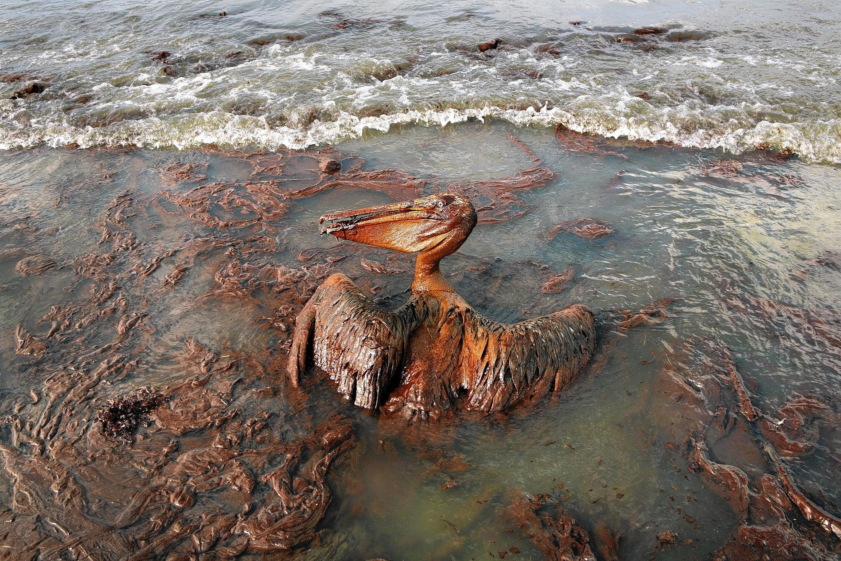
http://articles.latimes.com/2014/feb/23/business/la-fi-hiltzik-20140221

Slide 5
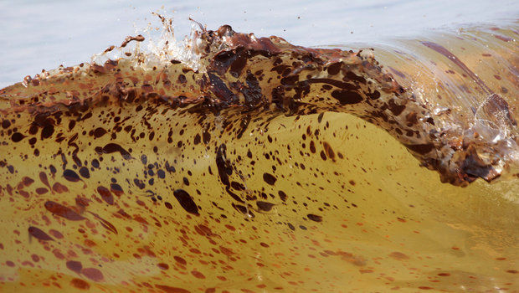
http://www.nola.com/environment/index.ssf/2015/05/5th_circuit_mexican_states_can.html

Slide 6
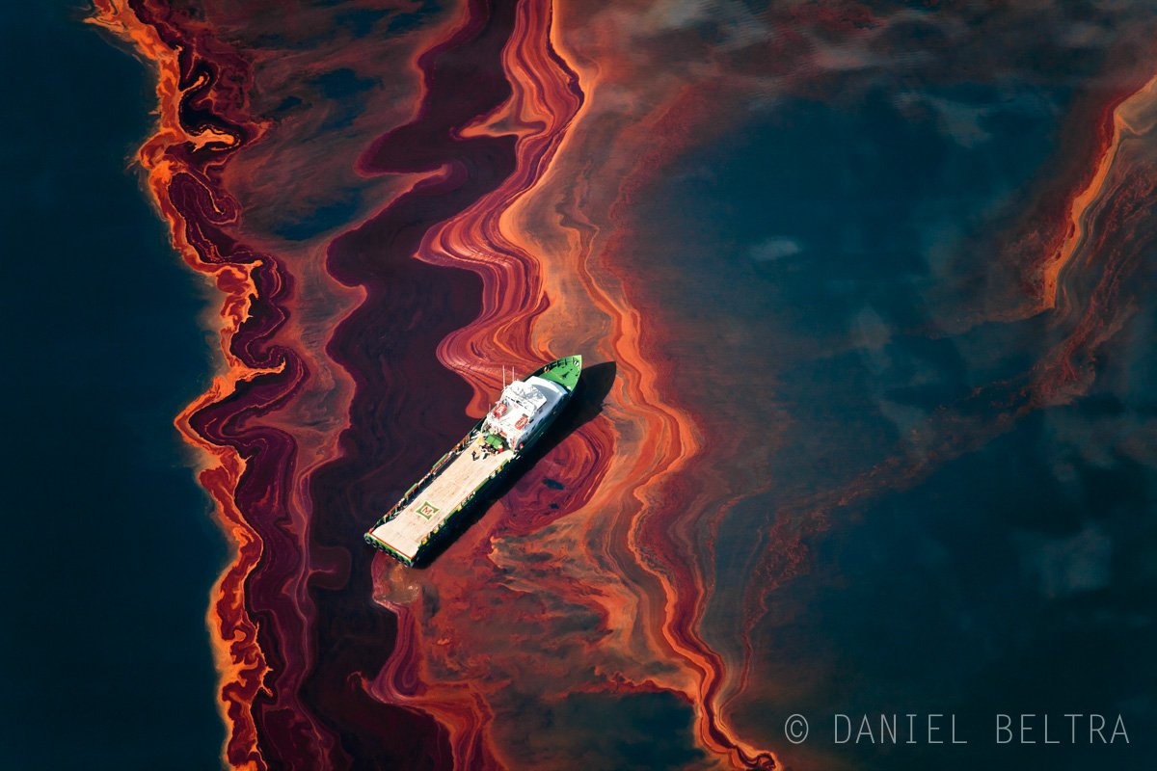
http://www.businessinsider.com/daniel-beltras-photos-of-the-2010-bp-oil-spill-2014-3

Slide 7
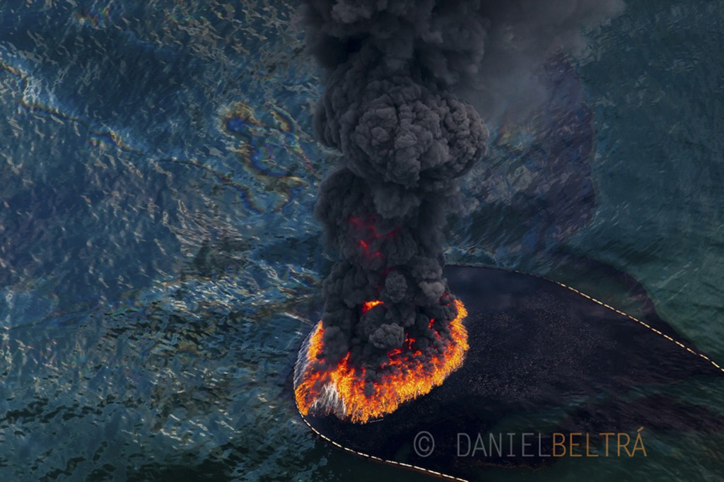
http://blogs.kcrw.com/whichwayla/2013/04/photographing-the-bp-oil-spill

Slide 8
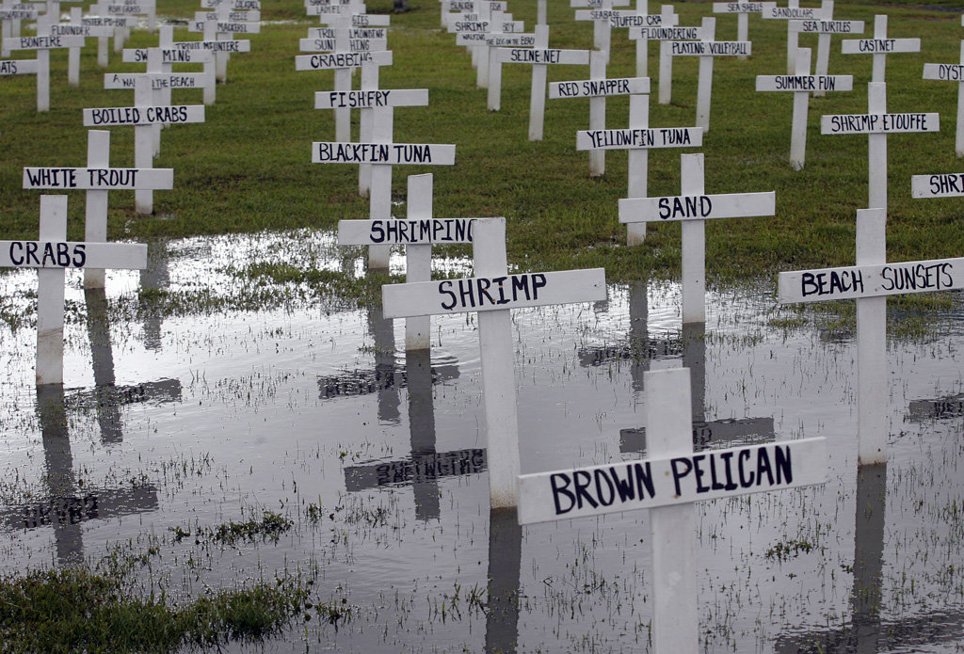
http://www.nola.com/news/gulf-oil-spill/index.ssf/2010/12/gulf_residents_businesses_say.html

Slide 9
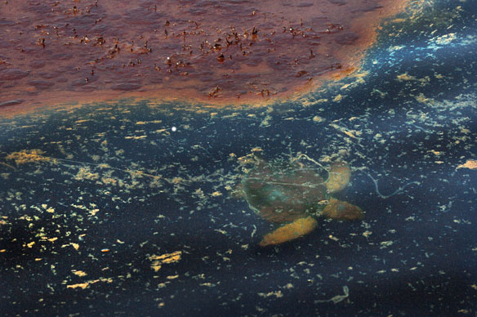
http://coastalcare.org/tag/gulf-oil-spill/page/6/

Slide 10
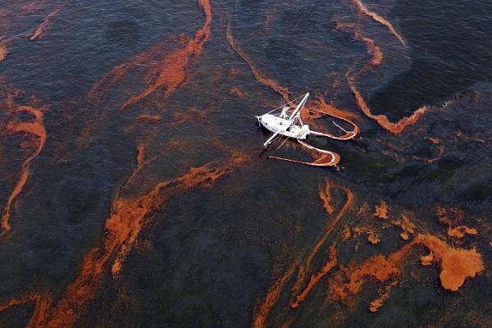
http://spirittrainchronicles.com/2013/02/

Slide 11
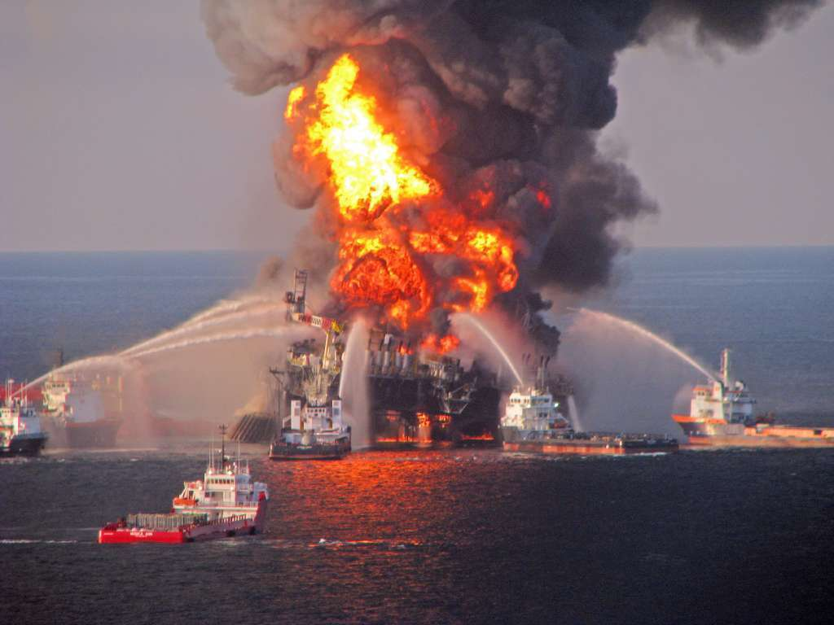
http://www.latimes.com/entertainment/movies/moviesnow/la-et-mn-bp-oil-spill-movies-20140820-story.html

Slide 12
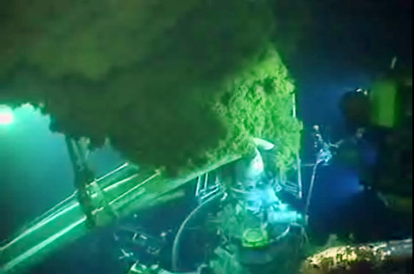
http://www.fcmlaw.com/blog/file-a-bp-oil-spill-claim-before-the-deadline/

Slide 13
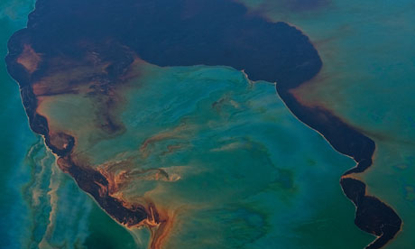
http://www.theguardian.com/environment/2013/oct/15/bp-oil-spill-halliburton-manager-guilty-destroying-evidence

Slide 14
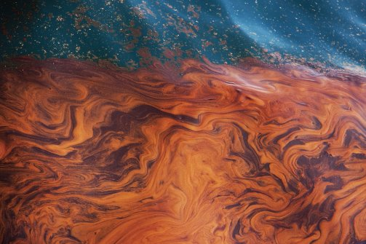
http://dailybail.com/home/report-gulf-oil-spill-was-much-worse-than-bp-admitted.html

Slide 15
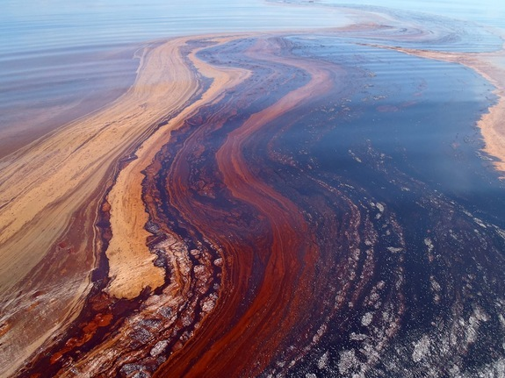
http://www.livescience.com/23126-bacteria-sucked-up-200-000-tons-of-oil-after-bp-spill.html

Slide 16
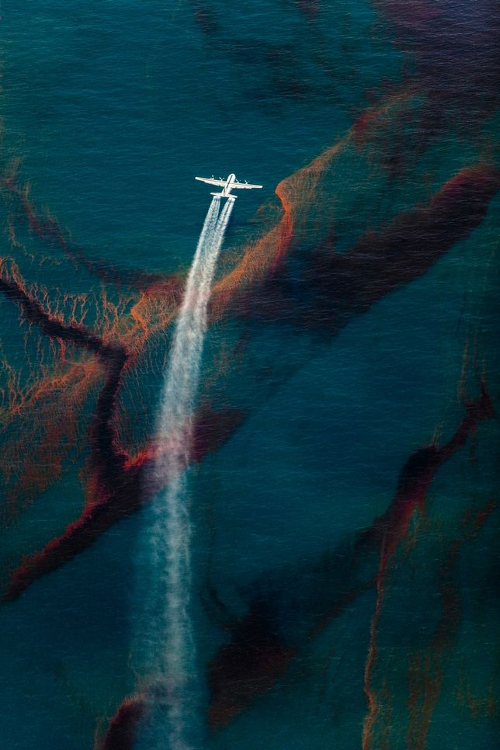
http://www.treehugger.com/slideshows/ocean-conservation/daniel-beltras-amazing-photos-see-the-bp-oil-spill-like-never-before/page/10/

Slide 17
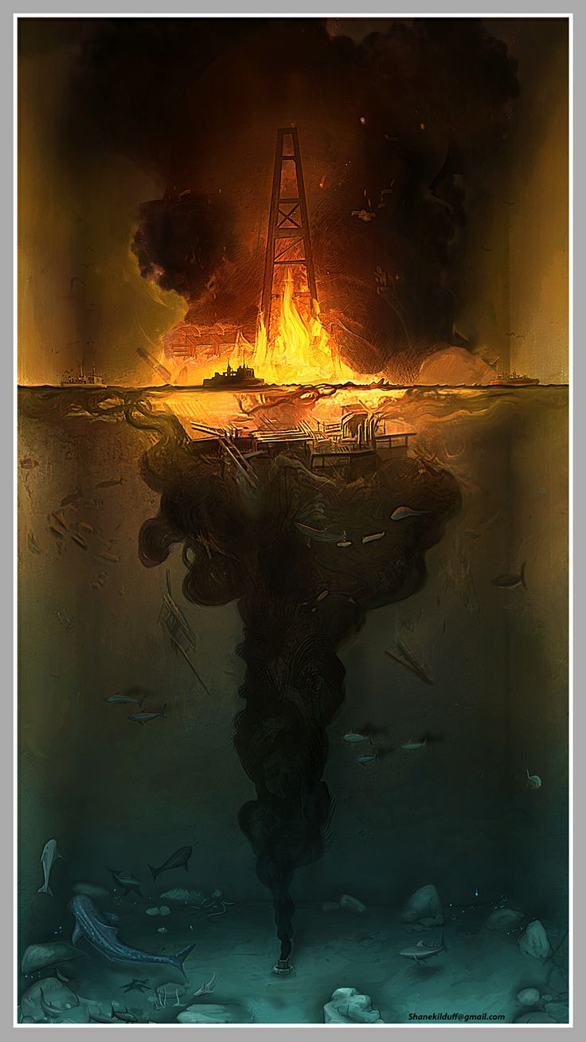
https://www.pinterest.com/pin/11610911509343824/

Slide 18
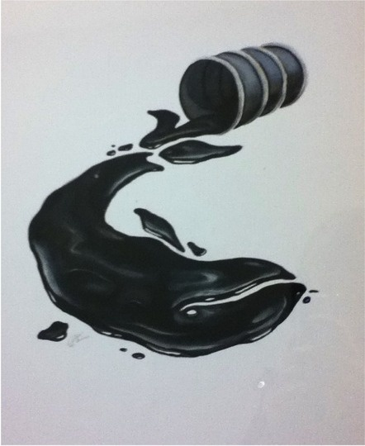
https://www.pinterest.com/pin/117515871497971907/

Slide 19
Recreate your own painting
Students are to create a painting representing the oil spill, how they see it. The painting must be on a large canvas (11 X 18 is optimal, but any size could work). The goal is to allow the students to express themselves in how they see the oil spill after being exposed to a variety of mediums. The rubric below will be used to grade the piece.

Slide 20
Rubric for painting
CATEGORY | 25 | 21.5 | 18.5 | 16
Design/ Composition | Student applies design principles (such as unity, contrast, balance, movement, direction, emphasis, and center of interest) with great skill. | Student applies design principles (such as unity, contrast, balance, movement, direction, emphasis, and center of interest) with fair skill. | Student tries to apply design principles (such as unity, contrast, balance, movement, direction, emphasis, and center of interest) but the overall result is not pleasing. | The student does not appear to be able to apply most design principles to his/her own work.
Drawing | Drawing is expressive and detailed. Shapes, patterns, shading and/or texture are used to add interest to the painting. Student has great control and is able to experiment a little. | Drawing is expressive and somewhat detailed. Little use has been made of pattern, shading, or texture. Student has basics, but had not \"branched\" out. | Drawing has few details. It is primarily representational with very little use of pattern, shading or texture. Student needs to improve control. | The drawing lacks almost all detail OR it is unclear what the drawing is intended to be. Student needs to work on control.
Creativity | Student has taken the topic being discussed and applied it in a way that is totally his/her own. The student\'s personality/voice comes through. | Student has taken the topic being studied and has used source material as a starting place. The student\'s personality comes through in parts of the painting. | Student has copied some painting from the source material. There is little evidence of creativity, but the student has done the assignment. | Student has not made much attempt to meet the requirements of the assignment.
Time/Effort | Class time was used wisely. Much time and effort went into the planning and design of the mask. It is clear the student worked at home as well as at school. | Class time was used wisely. Student could have put in more time and effort at home. | Class time was not always used wisely, but student did do some additional work at home. | Class time was not used wisely and the student put in no additional effort.

